Slide 1
Data Link Layer Part I: Introduction and Addressing

Slide 2
Where are we now?
Introduction to Networking
Basic Queuing Theory
Application Layer
Transport Layer
Network Layer
Data Link Layer
Medium Access Control SubLayer
Physical Layer
Further subjects (we will decide what to talk about based on the time left at the end of the semester)

Slide 3


Layered Architecture: Application Layer
host or
server
host or
server
application
transport
controlled by
app developer
application
transport
process
process
Ankara
Internet
Pittsburgh
Application: Firefox
Application data: Jpeg image, HTML text
Application layer protocol: HTTP
Defines the rules to communicate the application data between the processes
Application layer: Only exists at the end systems
needs the HTTP messages to be transmitted from sender process to receiver process
Gives the HTTP messages to the transport layer

Slide 4
Layered Architecture: Transport Layer
host or
server
host or
server
controlled by
app developer
application
transport
network
application
transport
network
process
process
Ankara
Internet
Pittsburgh
Transport layer protocol: TCP/UDP
Encapsulates application layer messages in segments
Transmits the data from sender process to receiver process
Transport layer: Only exists at the end systems
Needs the segments to be transmitted from sender host machine to receiver host machine
Gives the segments to the network layer

Slide 5
Layered Architecture: Network Layer
Network Layer: exists in every host, router
Needs:
To send the packet reliably from one node to other node
Such that it gets to the destination node
Network Layer uses the services of the Data Link Layer
application
transport
network
data link
network
data link
network
data link
network
data link
network
data link
network
data link
network
data link
network
data link
l
network
data link
application
transport
network
data link

Slide 6

Layered Architecture: Data Link Layer
Some terminology:
hosts and routers are nodes
communication channels that connect adjacent nodes along communication path are links
wired links
wireless links
LANs
layer-2 packet is a frame, encapsulates datagram
data-link layer has responsibility of
transferring datagram from one node
to adjacent node over a link

Slide 7
Overall Picture: Data Link Layer and Medium Access Control
Data Link Layer: Creating a reliable link requires:
This transmission should be reliable ➔ Data Link Control
Network nodes should be able to transmit over the physical channel as if nodes are connected by a direct link ➔ Medium Access Control (Later)
(think of wireless links, there is no direct link!!!!)
…
Network
DLC
MAC
Physical
DLL
DLL: Data Link Layer
DLC: Data Link Control
MAC: Medium Access Control

Slide 8
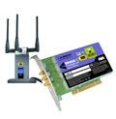
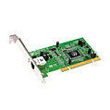
Where is the data link layer implemented?
in each and every host
link layer implemented in “adaptor” (aka network interface card NIC)
Ethernet card, 802.11 card
implements link, physical layer
attaches into host’s system buses
combination of hardware, software, firmware
host schematic
application
transport
network
link
cpu
memory
link
physical
host
bus
(e.g., PCI)
controller
physical
transmission
network adapter
card

Slide 9
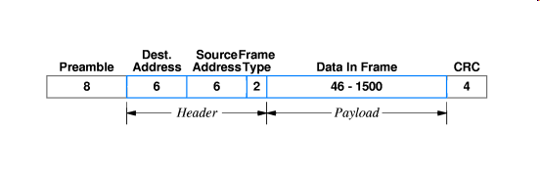
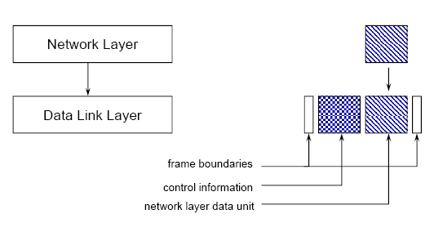
Framing: Frames and packets
Relationship between packets and frames.
IP Packet (IP header+ IP payload)
Example: IEEE 802.3 (Ethernet) Frame
Bit pattern to show
beginning of the frame
Physical address (PHY)
Error checking pattern

Slide 10
Adaptors and Addressing
datagram
link layer protocol
rcving
node
sending
node
frame
frame
adapter
adapter
link layer implemented in “adaptor” (NIC)
Ethernet card, 802.11 card
Each NIC has an address (Physical address, MAC address)
Each frame has a destination physical address
When a frame arrives on the physical link, NIC checks if the destination address matches NIC address.
If there is a match accepts the frame, else discards the frame
Interface: Adaptor device+Protocol

Slide 11
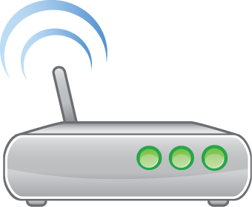




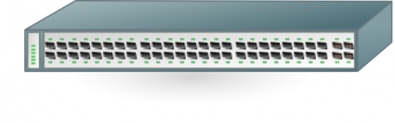

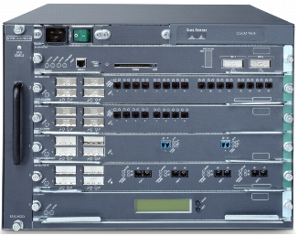
Interfacing Examples
Wireless Access point
IEEE 802.3
(Ethernet)
100Mbps
Twisted Pair Copper Cable
Host1
IEEE 802.11
(WiFi)
54Mbps
2.4GHz Radio
IEEE 802.3
(Ethernet)
Switch
IEEE 802.3
(Ethernet)
Host2
Router
OC-48
2.5 Gbps
Fiber Optic TDM
Router

Slide 12
Interfacing
Wireless Access point
IEEE 802.3
(Ethernet)
Host2
Host1
IEEE 802.11
(WiFi)
Host 1 sends an IP packet to Host 2
Host 1 to WAP:
IP packet is encapsulated in 802.11 Frame
Source PHY: Host1 802.11 address
Dest PHY: WAP 802.11 address

Slide 13
Interfacing
Wireless Access point
IEEE 802.3
(Ethernet)
Host2
Host1
IEEE 802.11
(WiFi)
Host 1 sends an IP packet to Host 2
WAP to Host2:
IP packet is encapsulated in 802.3 Frame
Source PHY: WAP 802.3 address
Dest PHY: Host2 P 802.3 address

Slide 14
Interfacing
Wireless Access point
IEEE 802.3
(Ethernet)
Host2
Host1
IEEE 802.11
(WiFi)
Host 1 sends an IP packet to Host 2
Protocol might change crossing every device
Source, Dest PHY addresses change
IP packet never changes
Remember NAT!
That is not the desired operation!

Slide 15
How does the packet go from source host to destination host
We go back to our previous Problem:
Host X wants to browse the web site of MyCompany located on Host Y
Host X and Host Y can be on two different subnets with many other networks in between
Company Network
National ISP
Academic ISP
Host Y:
MyCompany Web Server
University Network
Host X browses:
www.mycompany.com.tr

Slide 16
How does the packet go from source host to destination host
RY: Last Router on the path
Company Network
National ISP
Router actions at the network layer:
RX sends the packet in the correct direction to the destination subnet according to the Routing Table entry
Entry constructed by the help of Inter-AS + Intra-AS algorithms
Finally RY gets the IP packet
Academic ISP
WE KNOW THIS PART!!!
University Network
RX: First Router on the path

Slide 17
How does the packet go from source host to destination host
RY: Last Router on the path
Company Network
National ISP
In the same subnet: From host X to RX (device to device)
Router to router (device to device)
In the same subnet: From RY to host Y (device to device)
Academic ISP
University Network
DEVICE TO DEVICE DELIVERY
RX: First Router on the path

Slide 18
IP Addresses and Physical Addresses
Each device interface to the network has two addresses:
IP address (Logical address):
Hierarchical structure➔ Routers can use the network portion of the address to make routing decisions.
Administrative configuration, can be changed
Medium access control (MAC) Address (Physical address):
Depends on the physical layer protocol and means of communication
Usually assigned in the factory and cannot be changed
Depends on the manufacturer
THESE TWO ADDRESSES ARE INDEPENDENT AND NOT DERIVED FROM EACHOTHER IN ANYWAY

Slide 19
Addressing
Only destination addresses are shown
User data
D
Application Layer Message
H_{A}
D
Transport Layer Address: TCP/UDP port (16 bits)
80
H_{A}
D
Network device address: IP Address (32 bits)
144.122.166.16
80
H_{A}
D
Physical Device Address:
Ethernet Address (48 bits)
35-18-DC-FA-4B-32
144.122.166.16
80
H_{A}
D
Host: HTTP Server

Slide 20
IP Addresses and Physical Addresses
Example1:
A metu computer with IP address 144.122.160.90 has 10/100 Ethernet NIC, replace it by Gbit Ethernet NIC
Completely different NIC hardware, but can keep the same IP address
Example 2:
A Laptop is connected to TTNET. Assigned a TTNET IP address ( 88.233.112.121)
Then connects to metu network. Assigned 144.122.165.120
Completely different IP addresses same NIC hardware

Slide 21
IP Addresses and Physical Addresses
All hosts have:
Network layer address ➔ Global Identification
Physical address➔ Identification in the subnet
Network Layer address:
32-bit IP address:
used to get datagram to destination IP subnet
Physical address:
Also called Medium Access Control (MAC) address
used to get datagram from one interface to another physically-connected interface (same subnet)

Slide 22
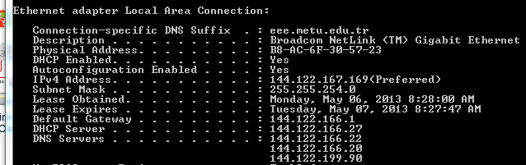
Routing: The entire story
REMEMBER: When a host is added to a network via DHCP or manual configuration it learns and configures its tables with:
Its own IP address
Its own subnet address (32 bit host address(IPv4 Address)+32 bit mask (Subnet Mask) )
IP of the DNS server on the network (DNS Servers)
IP address of the first router’s interface on the subnet (Default Gateway)

Slide 23
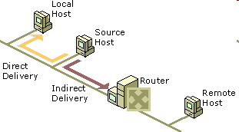
Routing: The entire story
When a host wants to send data to another host, it must first obtain the IP address of the destination.
The destination IP address is obtained through Domain Name System (DNS).
Once the destination IP address has been obtained, the source subnet and the destination subnet addresses are compared.
Destination subnet add = Source subnet add ➔ Direct delivery to the destination
There is a direct physical connection, without the router.
Destination subnet add ≠ Source subnet add ➔ Indirect delivery via the router.
HOW DO YOU MAKE THIS COMPARISON?

Slide 24
Routing: The entire story
Source subnet address=Source IP address AND Source Subnet Mask
Check if:
Destination IP address AND Source Subnet Mask==Source Subnet Address

Slide 25
Direct Delivery
User data
D
message
H_{A}
D
segment
H_{T}
H_{A}
D
datagram
Dest IP: IP A
H_{T}
H_{A}
D
Frame sent from node X to Node A
Dest PHY: PHY A
Dest IP: IP A
H_{T}
H_{A}
D
Node A
Node B
Node X
Node X sends an IP datagram to node A (destination)
Node X and Node A are in the same subnet
Node X sends it to physical address of the destination
Notes:
25

Slide 26
Indirect Delivery
User data
D
message
H_{A}
D
segment
H_{T}
H_{A}
D
datagram
Dest IP: IP B
H_{T}
H_{A}
D
Frame sent from node X to Node B
Dest PHY: PHY R
Dest IP: IP B
H_{T}
H_{A}
D
Node A
Router R
Node B
Node X
PHY R
Node X sends an IP datagram to node B (destination)
Node X and Node B are NOT in the same subnet
Node X sends it to physical address of the intermediate Router
Notes:
26

Slide 27

How to determine the router for indirect delivery
Default route
The default route and its forwarding address to the default router are used when no other routes to the destination network are found.
Simplified configuration of hosts and routers
Reduced overhead associated with each host having routes for all the networks in the internetwork,
a sending host is configured with a single default route.
The Default Gateway for TCP/IP hosts in Windows is a default router.
The default gateway can also be automatically configured via DHCP

Slide 28
Routing: The entire story on the router side
Node C
Node B
Router will not be destination for user data packets but can be destination for network control packets.
When a router receives a packet that is not destined for that router, the router must either deliver it to the destination host or to another router
Node A
Router R1
Router R
Destination subnet add = one of the subnets that the router is attached to ➔ Direct delivery to the destination node (E.g: Node A to Node B)
Destination subnet add ≠ one of the subnets that the router is attached to ➔ Indirect delivery to the next router (E.g: Node A to Node C)

Slide 29
MAC Addresses and ARP
Analogy:
(a) MAC address: like TC Kimlik No
(b) IP address: like postal address
MAC flat address ➜ portability
48 bit MAC address burned in the adapter ROM
MAC address allocation administered by IEEE
IP hierarchical address NOT portable
depends on IP subnet to which node is attached

Slide 30
ARP: Address Resolution Protocol
Question: how to determine
MAC address of a host knowing its IP address?
Each IP node (Host, Router) on subnet has an ARP table (cache)
ARP Cache: IP/MAC address mappings for some LAN nodes
< IP address; MAC address; TTL>
TTL (Time To Live): time after which address mapping will be forgotten (typically 20 min) (Optional)
Broadcast address =FF-FF-FF-FF-FF-FF
= adapter
237.196.7.78
1A-2F-BB-76-09-AD
237.196.7.23
237.196.7.14
subnet
71-65-F7-2B-08-53
58-23-D7-FA-20-B0
0C-C4-11-6F-E3-98
237.196.7.88

Slide 31
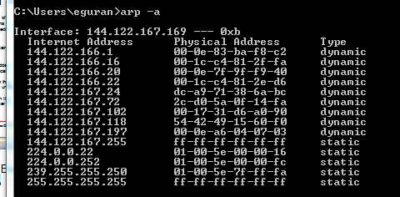
ARP Cache Example
You can view the ARP cache by using the arp command. To view the ARP cache, type arp -a at a command prompt. To view arp command-line options, type arp /? at a command prompt.

Slide 32
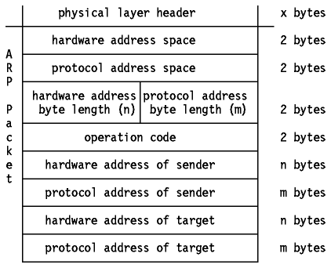
ARP Packet
Operation: Specifies the operation that the sender is performing: 1 for request, 2 for reply.
Hardware address of the Sender
ARP request: the MAC address of the host sending the request.
ARP reply: the MAC address of the host that the request was looking for
Hardware address of the Target
ARP request: ignored.
ARP reply: the address of the host that originated the ARP request.
Protocol address of the sender/target: IP address of the sender/target

Slide 33
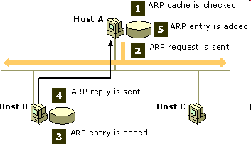
ARP: Direct Delivery
Hosts A and B, are on the same physical network.
Host A IP address of 10.0.0.99
Host B IP address of 10.0.0.100.
Host A tries to communicate with Host B, knows IP address to be used to reach Host B is 10.0.0.100
Host A checks its own local ARP table (cache) for a matching hardware address for Host B.
If Host A finds no mapping in the cache, it broadcasts an ARP request frame to all hosts on the local network with the question "What is the hardware address for 10.0.0.100?"
Each host on the local network receives the ARP request and checks for a match to its own IP address.
If a host does not find a match, it discards the ARP request.

Slide 34
ARP: Direct Delivery
Host B determines that the IP address in the ARP request matches its own IP address and adds a hardware/software address mapping for Host A to its local ARP cache.
Host B sends an ARP reply message containing its hardware address directly back to Host A.
When Host A receives the ARP reply message from Host B, it updates its ARP cache with a hardware/software address mapping for Host B.
Once the media access control address for Host B has been determined, Host A can send IP traffic to Host B by addressing it to Host B's media access control address.

Slide 35
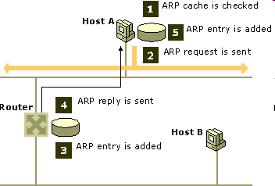
ARP: Indirect Delivery
ARP resolves the media access control address of a router interface on the local network.
Host A has an IP address of 10.0.0.99
Host B has an IP address of 192.168.0.99
Router interface 1 is on the same physical network as Host A and uses the IP address 10.0.0.1.
Router interface 2 is on the same physical network as Host B and uses the IP address 192.168.0.1.
Interface 1
10.0.0.1
Interface 2
192.168.0.1
Router that connects multiple networks has an interface (network capable hardware with individual IP and physical address) on each network.
A router has multiple interfaces
Has an ARP table for each interface and its subnet

Slide 36
ARP: Indirect Delivery
By table lookup Host A knows Host B is not on the same network. Packet must go through router. Host A knows the IP address of the router.
IP address to be used to reach host B is 10.0.0.1
Host A then checks its own local ARP cache for a matching hardware address for 10.0.0.1.
If Host A finds no mapping in the cache, it broadcasts an ARP request frame to all hosts on the local network with the question "What is the hardware address for 10.0.0.1?"
Interface 1
10.0.0.1
Interface 2
192.168.0.1
The router determines that the IP address in the ARP request matches its own IP address and adds a hardware/software address mapping for Host A to its local ARP cache.

Slide 37
ARP: Indirect Delivery
The router then sends an ARP reply message containing its hardware address directly back to Host A.
When Host A receives the ARP reply message from the router, it updates its ARP cache with a hardware/software address mapping for 10.0.0.1.
Interface 1
10.0.0.1
Interface 2
192.168.0.1
Once the media access control address for Router interface 1 has been determined, Host A can send IP traffic to Router interface 1 by addressing it to the Router interface 1 media access control address.
The router then forwards the traffic to Host B through the same ARP process.

Slide 38
More on ARP protocol
To minimize the number of broadcasts, ARP maintains a cache of IP address-to-media access control address mappings for future use.
The ARP cache can contain both dynamic and static entries.
Dynamic entries are added and removed automatically over time.
Soft state: information that times out (goes away) unless refreshed
Static entries remain in the cache until the computer is restarted.
ARP is “plug-and-play”:
nodes create their ARP tables without intervention from net administrator
You can view the ARP cache by using the arp command. To view the ARP cache, type arp -a at a command prompt. To view arp command-line options, type arp /? at a command prompt.

Slide 39
Exercise
237.196.10.135
D
C
subnet:
237.196.10/24
128.45.12.69
81-32-39-10-AC-71
4B-47-98-2C-AA-87
132.28.10.01
1A-2F-BB-76-09-AD
132.28.10.02
28-CA-99-10-10-BB
237.196.10.01
7A-44-34-76-19-12
subnet:
132.28.10/24
subnet:
128.45.12/24
R1
237.196.7.78
1A-2F-BB-76-09-AD
R2
237.196.7.23
128.45.12.01
47-02-A0-43-91-CC
A
subnet:
237.196.7/24
Define all steps of operation when A sends an IP packet to B,C,D
Identify the physical address of all frames that are sent
71-65-F7-2B-08-53
B
0C-C4-11-6F-E3-98
237.196.7.88

Slide 40
Data Link Layer Part I: Introduction and Addressing

